Slide 1

FUNDAMENTAL ENGINEERING
Class – 01
Introduction to programming in c/c++
October 2025
School of Engineering

Slide 2

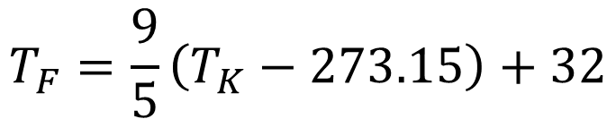
Problem #1
A scientific laboratory needs a program that allows temperatures recorded in Kelvin (K) to be converted to Fahrenheit (°F), so that the results can be understood by technicians who use the imperial system.
Write a C program that prompts the user for a temperature in Kelvin, performs the conversion, and displays the result in Fahrenheit to two decimal places. Requirements
The program must:
Prompt the user for a temperature in Kelvin.
Calculate the equivalent temperature in Fahrenheit.
Display the result on the screen with two decimal places.
Include comments that explain each step of the code.
Verify that the entered Kelvin value is greater than or equal to 0 (there are no negative temperatures in Kelvin).
$$T_{F}=\frac{9}{5}\left(T_{K}−273.15\right)+32$$

Slide 3


Problem #2
A physics student is analyzing the motion of an object launched vertically upward from the ground with a certain initial velocity. He wants to know the maximum height the object will reach before it begins to fall again.
Write a C program that asks for the initial velocity (m/s), calculates the maximum height (m) and displays the result on the screen.
The program must:
Prompt the user for the initial velocity (m/s).
Calculate the maximum height ℎ (m)
Display the result on the screen with two decimal places.
Use a constant for gravity: const float g = 9.81;
Verify that the initial velocity is greater than or equal to 0.
Include explanatory comments for the code.
$$h=\frac{v^{2}}{2g}$$

Slide 4

Problem #3
A chemist wishes to calculate the total molar mass (g/mol) of an organic substance composed solely of the elements Carbon (C), Hydrogen (H), Oxygen (O), and Nitrogen (N).
Create a C program that asks the user for the number of atoms of each element in the molecule and then calculates the total molar mass using the known atomic masses.
Name | Symbol | MW (g/mol)
Carbon | C | 12.01
Hydrogen | H | 1.008
Oxygen | O | 16.00
Nitrogen | N | 14.01
$$M=\text{(}n_{C}\text{​×}{MW}_{C}\text{)+(}n_{H}\text{​×}{MW}_{H}\text{)+(}n_{O}\text{​×}{MW}_{O}\text{)+(}n_{N}\text{​×}{MW}_{N}\text{)}$$

Slide 5
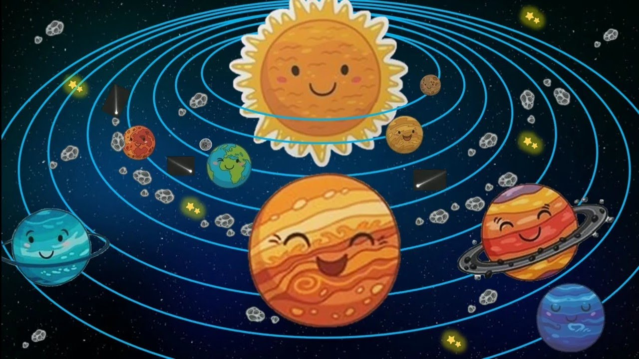
Problem #4
Write a menu-driven program that requests a person's weight and prints their weight on any planet in the solar system to the screen. Use the following equivalents as references.
Name | equivalent
Mercury | 0.38
Venus | 0.91
Earth | 1.00
Mars | 0.38
Jupiter | 2.53
Saturn | 1.06
Uranus | 0.92
Neptune | 1.24

Slide 6


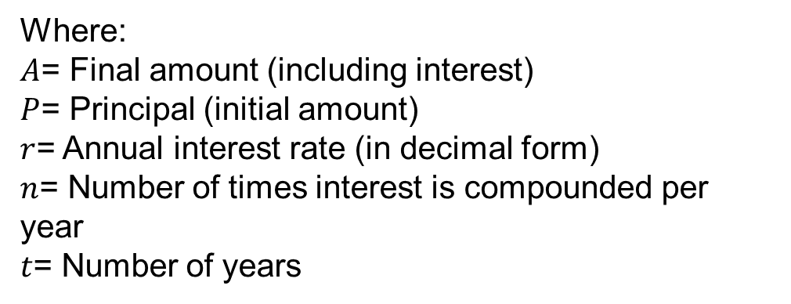

Problem #5
A bank offers compound interest on savings accounts.
You are asked to write a program that calculates the final balance after a certain number of years, given:
The initial amount deposited (principal).
The annual interest rate (as a percentage).
The number of times per year the interest is compounded.
The number of years the money is kept in the bank.
The earning cannot pass 200%
Where:
$A$= Final amount (including interest)
$P$= Principal (initial amount)
$r$= Annual interest rate (in decimal form)
$n$= Number of times interest is compounded per year
$t$= Number of years
$$A=P{\left(1+\frac{r}{n}\right)}^{n∗t}$$
Compound Interest formula:
Total interest earned:
$$I=A−P$$

Slide 7
Questions?
Thank you for your attention!!!

